Slide 1
KGP Learnings
Online Class Management System
Software Engineering Laboratory
1

Slide 2

PROBLEM DEFINITION
A web-based class management system like MS Teams which will majorly comprise of two major use cases: Students and Professors. The main focus for the software will be uploading lectures, implementation of live classes is a bonus.
2

Slide 3
Why the problem/project is important?
The COVID-19 has resulted in schools shut down all across the world. Globally, over 1.2 billion children were out of the classroom.
As a result, education has changed dramatically, with the distinctive rise of e-learning, whereby teaching is undertaken remotely and on digital platforms.
It's flexible.
Customized learning
Studying online teaches you vital time management skills, which makes finding a good work-study balance easier.
Teacher can integrate ebooks, videos, pictures, doubt discussion to improve lessons.
It’s accessible
Cost effectiveness
The virtual classroom is also available anywhere there’s an internet connection, and a good way to take advantage of this is to travel.
Online education tends to be more affordable.You can also save money from commute and class materials, which are often available for free.
Vastness
In a space as vast and wide as the internet, there are infinite skills and subjects to teach and learn.
3

Slide 4
SALIENT FEATURES
4

Slide 5
Live Classes
01
Zoom
Live class is integrated with zoom API.
02
One click
Just by filling few entries , class can be scheduled in a single click.
5

Slide 6
Messaging
Student
They can message teachers about their concern.
Teacher
Teacher can answer the query according to his/her wish.
6

Slide 7
ASSIGNMENT
Upload
Update
Delete
Submit
The teacher can upload multiple assignments in any specific time with deadline.
The teacher can update the deadline as well as the main document of the assignment.
If teacher has uploaded assignment by mistake, then deletion is also allowed
Student can access and submit the assignment before deadline.
7

Slide 8
CLASS TEST
Upload
Teacher can put the google form link or drive link containing test paper and space for submission.
Delete
Access
Teacher can delete the class test.
Student can access the link for test.
8

Slide 9
CLASS NOTICE
Teacher can add class notice for all the students who are added in class.
Publishing Time is also visible along with the Notice, sorted according to the time.
I am going to take class test on next wednesday.
Dear students , your marks has been updated .
Today’s lecture is rescheduled to 11A.m.
Today is the last day for assignment submission. No extra time will be given.
Deadline of the Python GUI Assignment has been extended.
Tomorrow , we will not have any class due to Holi.
Teacher
9

Slide 10
User Signup
Password
Mobile no.
Capital and small alphabet along with number and characters are needed.
No specific format needed.
Email
Name
Standard mail format is needed.
Name of the user should be provided.
Username
Subject / Roll no.
Username should not match with any existing username
Subject(for teacher)
Roll no. (for student)
10

Slide 11
User Login
Username
Password
Username should be same as given during sign up.
Password should match as given during sign up.
11

Slide 12
Study Material/Video Lectures
Upload
Update
Delete
Download
The teacher can upload study material/lectures in any specific time.
The teacher can update the study material / lectures
If teacher has uploaded any thing by mistake, then deletion is also allowed
Student can download the study material/video lectures.
12

Slide 13
CHALLENGES
FACED
13

Slide 14
Challenges faced
Live Class
Linking data between Teacher and Student
01
02
03
04
Advancement in User Authentication
Deletion / Updation
14

Slide 15
PROGRAMMING LANGUAGES USED
Python
CSS
HTML
For writing backend using Django framework
For writing Style Sheets
For writing markdown
15

Slide 16

Why Django?
Batteries Included
Built-in Admin UI
Django is popular for “batteries included” which means you can find almost everything to develop a full-fledged application like - ORM, Authentication, HTML templating etc.
The admin panel is well structured and it allows developers to create/update/delete users and any other database objects specific to the app.
ORM
ORM (Object-Relational Mapper) is a library that helps developers to interact with databases and allows them to transfer the data automatically from the databases to the objects.
Integration
Easy integration with Database, HTML templates and stylesheets.
16

Slide 17

Why SQLite3?
Free, secure & fast
Well Structured
SQLite3 is easy to use, fast, secure, flexible and free to use database management system.
SQLite lets you store data in structured manner. SQLite databases can also be queried and the data retrieval is much more robust.
Integration
High Performance
Easy integration with Django make it an ideal choice.
It can manage low to medium-traffic HTTP requests. SQLite3 is much faster than MySQL database.
17

Slide 18
IMPROVEMENTS COULD HAVE BEEN DONE
Upgradation of Class Test feature
Security Features
This feature can also be extended to larger extents like - live tests, without any third party APIs.
We can also implement the captcha and OTP for highly secured user authentication.
Helping Bot
New users can ask queries related to the platform from the bot and will get satisfactory answers.
Avoiding APIs for Live CLass
We can build our own live class feature from scratch avoiding use of any third party APIs.
Calling Feature
Status of User
Calling feature can also be implemented to connect each and every user.
This feature can show the current status of user (online/offline/busy).
18

Slide 19
DEMO VIDEO
https://youtu.be/OqejVcYp3Fo
19

Slide 20
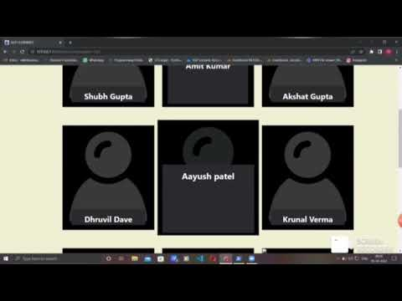
20

Slide 21
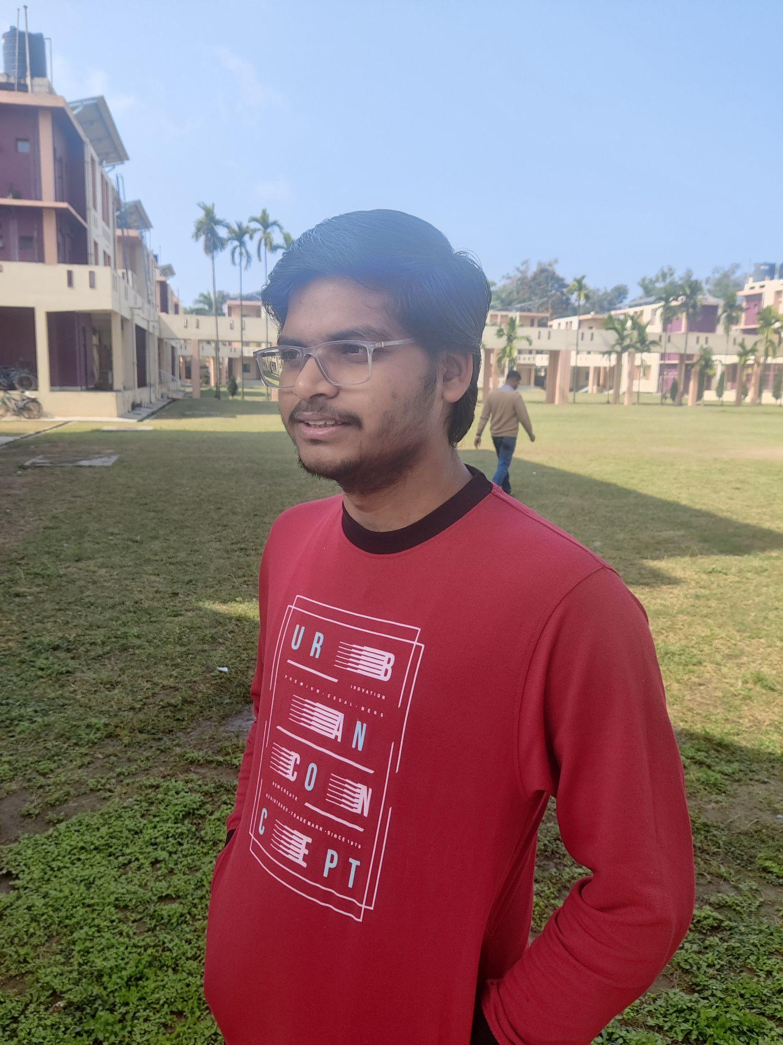


Amit Kumar Nikhil Saraswat Mir Mohammad Wasif
20CS30003 20CS10039 20CS10035
OUR TEAM
21

Slide 22
THANK YOU
22

